Slide 1
2018 - 2019 LaunchED Open House

Slide 2
at Lake Como School

Slide 3
LaunchED Open House Purpose
To support parents with understanding to access digital tools and resources at home.
To support parents with managing their student’s device at home.
Notes:
“This open house is designed as the third installment of a three part series for parents. The first session was at the May Parent Academy and focused on why Orange County Public Schools is transitioning to digital learning. The second session was virtual in June and focused on what specifically would be changing in the classroom. The sessions from May and June are available on our school’s website and Facebook page. This session is designed to focus on the how. We will be sharing how you can help your students with digital learning by learning to access digital tools and resources and how to manage the device.”

Slide 4
LaunchED Open House Schedule
Digital Learning Transition Overview
Digital Learning Question & Answers
Digital Learning Classroom Experience Overview
Laptop Checkout Sign Up
Notes:
“The schedule for today’s open house will include a brief overview of the transition to digital learning here in the auditorium/ cafetorium, a chance for you to share any additional questions or concerns that you have, and then a hands-on digital classroom experience.” You will then have a chance to sign up for checkouts the next couple of days for a specific time slot.

Slide 5
Superintendent’s Message
Notes:
“Let’s begin today by hearing about the direction for digital learning directly from the superintendent!”
Click to play message: https://ocpsondemand.ocps.k12.fl.us/?g=874129b9-45d9-11e5-910d-ecf4bbd89938 or https://drive.google.com/open?id=0B_75sGARN-S3SkI1QmpBVzZ0N1k
Notes: After message introduce other distinguished guests and invite them to share their passion and enthusiasm for digital learning at your school.
Thank you Dr. Jenkins and our other distinguished guests. With their vision in mind, let’s address your questions about what is changing in classrooms we transition to digital learning.”

Slide 6
Notes:
“Each family will be provided with a LaunchED quick reference card which provides some of the most commonly requested information. Take a moment and review the card and think about any questions you may have.”

Slide 7
Questions & Answers
Notes:
Interactivity Idea: Facilitate question and answer sessions using a Padlet like this one.

Slide 8
LaunchED Classroom Experience Overview
Notes:
Allow at least 10 minutes for people to leave the auditorium and transition to designated classrooms.
Please arrive at your classroom within 10 minutes.

Slide 9
LaunchED Classroom Experience Topics
Device Features
Powering On
TouchScreen
Modes
Handling
Device Monitoring
LaunchPad
Canvas for Parents
Google Drive

Slide 10
LaunchED Device
Wednesday, August 1
Seventh Grade
8:30 - 12:30
Thursday, August 2
Eighth Grade
8:30 - 11:30
Sixth Grade
12:30 - 4:00
Firday, August 3
Make Up Date
9:00 - 12:00
Notes:
“Every student at LaunchED sites like ours is provided with their own digital device at no cost. This device can be picked up during the times listed on the screen. It is very important that your student bring their Student ID with them when come to pick-up their device.”

Slide 11
Your Student’s LaunchED Device
Notes:
“Your child’s digital device is a laptop that they will use everyday in almost everything they do. They will use their device for research, to access their book and assignments, as a calendar, highlighter, calculator, and even to check their grades.”

Slide 12
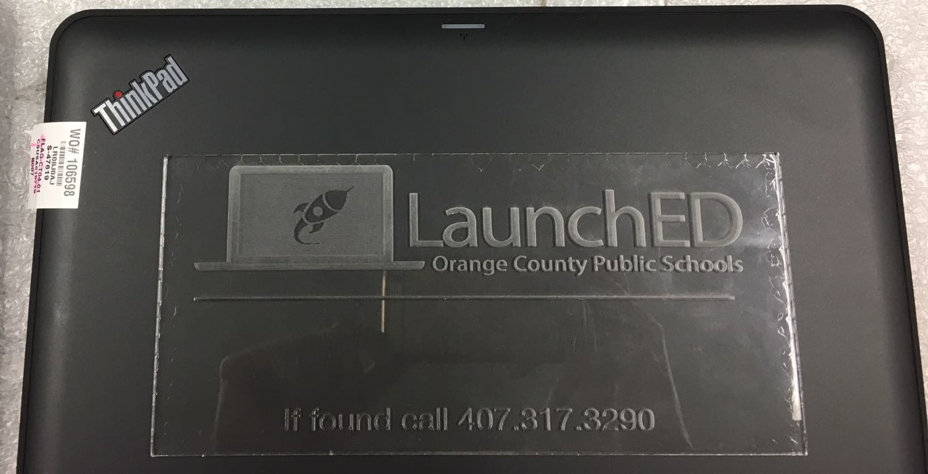
Notes:
“Your child’s device is designed to stand up to continuous respectful use. The device is ruggedized and etched for security. Each device have the program and district name laser etched into the materials with a number that anyone can call if they laptop is found unattended.”
Note: Show sample etching

Slide 13
Power On
Press here to power the device on.
Notes:
“One of the first questions students may ask you at home is how to turn the device on. The power button is located on the rear left hand side of the device when it is opened.”
Notes: The facilitator should model how to find it and encourage parents to work in pairs to find the power button.

Slide 14
Device Features
Use the touchscreen with your finger or a stylus.
Notes:
“Next let’s examine some of the important device features. The device works on the windows 10 platform which means that it is touchscreen enabled. When you click the windows button, you will see many color tiles.”
Model how to get to the tiles.
“Each of these tiles is an application to your student can use.”
Encourage parents to explore a few of the tiles such as FreshPaint.

Slide 15
Notes:
Model how to get to the tiles.
“Each of these tiles is an application to your student can use.”
Encourage parents to explore a few of the tiles such as FreshPaint.

Slide 16
Device Features
Notebook Mode – Best for productivity tasks such as taking notes or doing research.
Stand Mode – Perfect for web conferences and watching videos.
Notes:
“ The device can also be used for touch based tasks and flipping through photos or browsing the web. From stand mode, flip stand both sides of the device up like a tent. This is called tent mode. Try it out!”
Notes: Facilitators need to facilitate as parents work in pairs to flip devices into tent mode.
“The last and probably one of the most frequently used modes is tablet mode, which is similar to how you use a smart phone or an e-reader. Many students choose to read their textbooks this way. To get to tablet mode, just snap the tent shut. In this mode, the keyboard is disabled. Try it out!”
Notes: Facilitators need to facilitate as parents work in pairs to flip devices into tablet mode.

Slide 17
Device Features
Tent Mode – Good for touch-based tasks like graphing, sketch-noting, and viewing images or documents.
Tablet Mode – Great for reading documents and watching videos.
Notes:
“ The device can also be used for touch based tasks and flipping through photos or browsing the web. From stand mode, flip stand both sides of the device up like a tent. This is called tent mode. Try it out!”
Notes: Facilitators need to facilitate as parents work in pairs to flip devices into tent mode.
“The last and probably one of the most frequently used modes is tablet mode, which is similar to how you use a smart phone or an e-reader. Many students choose to read their textbooks this way. To get to tablet mode, just snap the tent shut. In this mode, the keyboard is disabled. Try it out!”
Notes: Facilitators need to facilitate as parents work in pairs to flip devices into tablet mode.

Slide 18
Notes:
“When your child brings home their device you will also notice there are two stickers on the keyboard that should not be removed. The purple one above the keyboard gives them the main features of our online toolbar and the black sticker reminds them of the address for the student tech request system which they will use to report a device technical issue.”

Slide 19
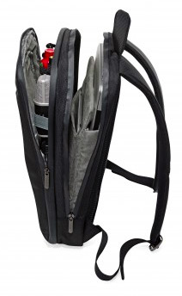
Device Handling
Students must carry their device in the backpack when walking in between classes and when traveling to and from school daily.
Choosing a backpack with a laptop pocket inside or a buying a padded sleeve would be wise!
Notes:
“ In order to keep all of the features of the device working well, it is important to handle the device with care. Please note that students must carry their device in the backpack when walking in between classes and when traveling to and from school daily. When choosing a backpack for your child this year, it may be wise to choose one with a built-in backpack sleeve or padding. “

Slide 20
Device Charging
Students must charge their devices overnight so that it lasts allday
It is helpful to bring the charger labeled with their name just in case.
Limited outlets are available at school for emergency use.
If a student loses the provided charger, they will need to purchase a new one from the Media Center.
Notes:
“Another issue that is critical for parents to consider is where and how their student will charge their device each night. The student devices are designed to last the majority of the school day when fully charged overnight using the provided outlet. They are some outlets available in each classroom for emergency use only. There are not enough outlets for all students to rely on charging their device at school. Device chargers are easy to misplace if you don’t have a designated place to keep them at home. If a student loses the charger they were provided then they will need to purchase a new one from the school. Please do not attempt to purchase one on your own.”

Slide 21
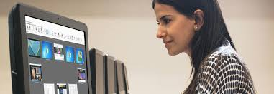
Device Monitoring

Slide 22
Device Monitoring
Your student’s device is monitored using classroom management software.
This allows the teacher to see what the student is doing and also keep everyone on track and on task.

Slide 23
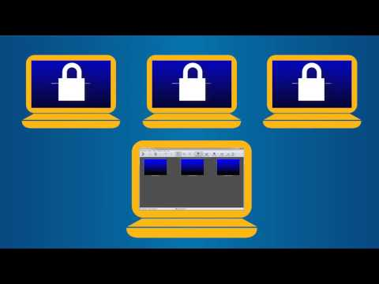
LanSchool at a Glance
Notes:
“Let’s see how it works by watching this quick clip.”

Slide 24
by ClassLink

Slide 26
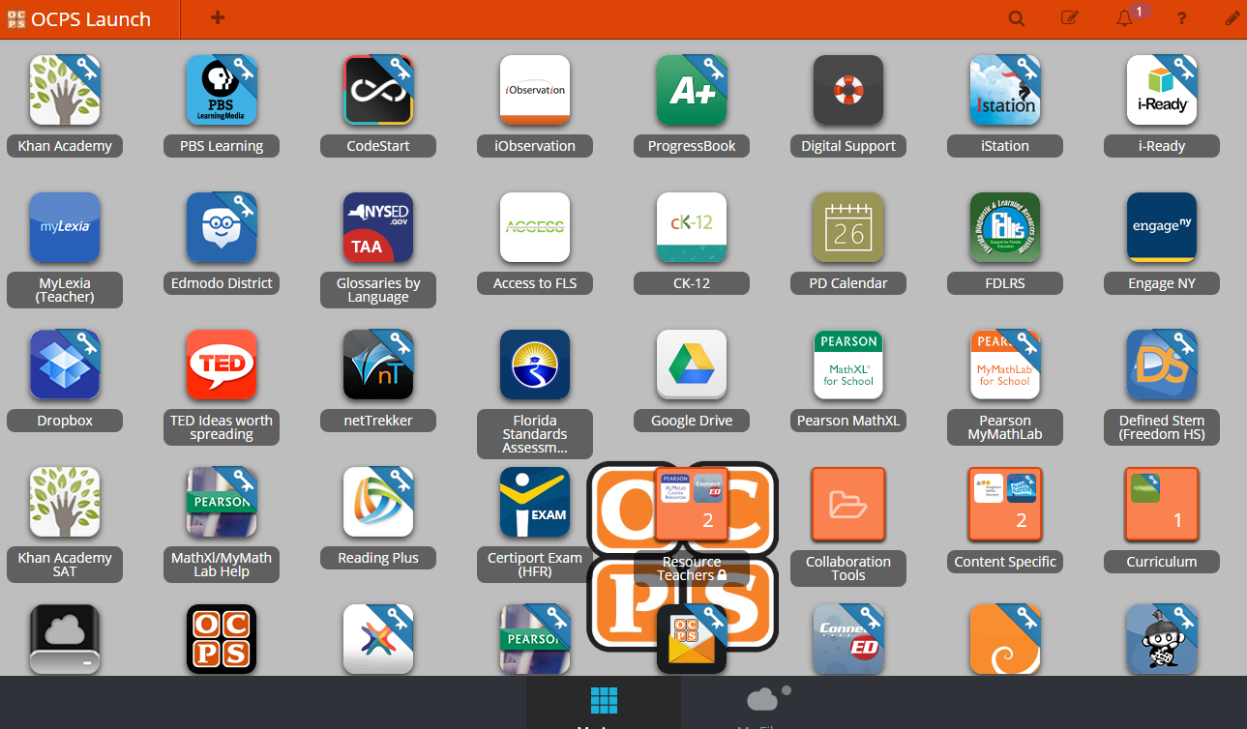
What can I find on LaunchPad?
Access to online textbooks, Edmodo, Google Drive, library media center resources, web apps and more
Notes:
“Finding your students digital files and binder is a breeze and so is finding their electronic textbooks. The LaunchED program uses a Launchpad for all students so that they can find all of their resources in one place with only one login. This login is the same login they use to log on to their computer. Let’s take a look at a sample Launchpad.”

Slide 27
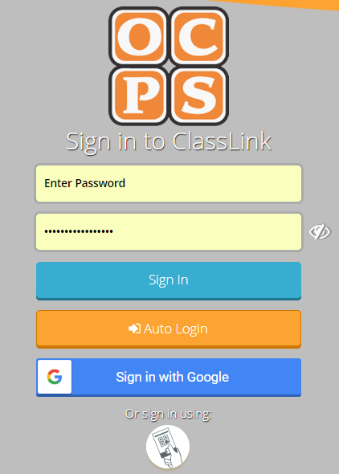
How do I access LaunchPad?
launch.ocps.net
Search Classlink

Slide 28
Canvas for Parents

Slide 29
What is Canvas?
Secure learning network for teachers, students, and schools.
Safe way for teachers and students to
connect
share content
access homework
participate in discussions
manage due dates
receive class information

Slide 30
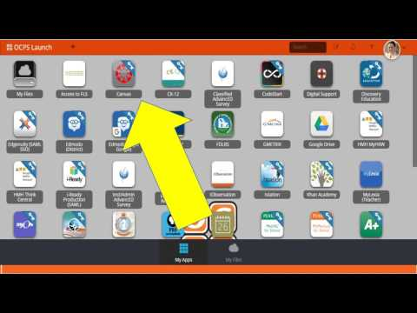

Slide 31
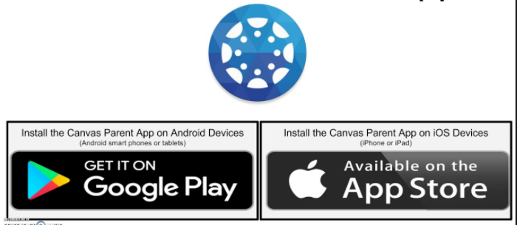
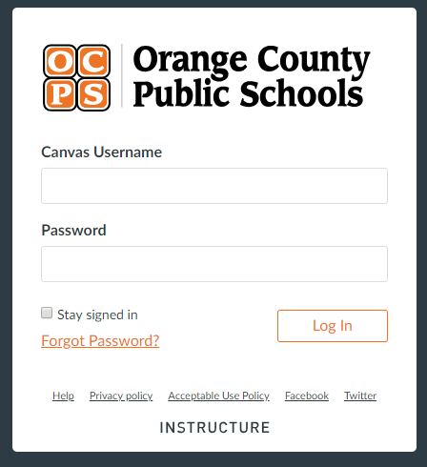
Where do I login to Canvas?
canvasparent.ocps.net
https://ocps.instructure.com/login/canvas

Slide 32
How do I sign up for a Parent Account?
Visit canvasparent.ocps.net
Click on parent login icon
Parents will need a “Join Code” which can be provided by the student or teacher
Parent account registration information will be distributed at the start of the school year through the Canvas Parent website, the school website, social media, flyer, and Connect Orange.

Slide 33
Google Drive

Slide 34
What is Google Drive?

Slide 35
What can students do with Google Drive?
Cloud-based storage, communication, and collaboration
Create docs, slides, sheets, drawings, and more
Use docs for essays and research papers
Use slides for presentations
Use sheets for math and data analysis
Use drawings for infographics and posters

Slide 36
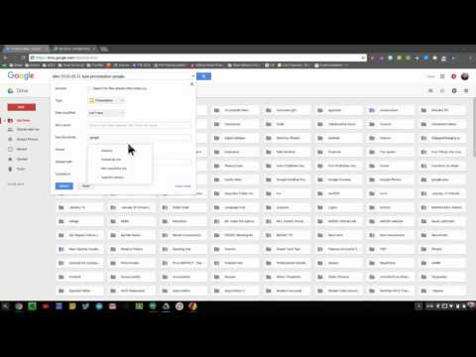
How can I search my student’s Drive?
Notes:
Stop video at 2 minutes.

Slide 37
Student & Parent Responsibilities

Slide 38
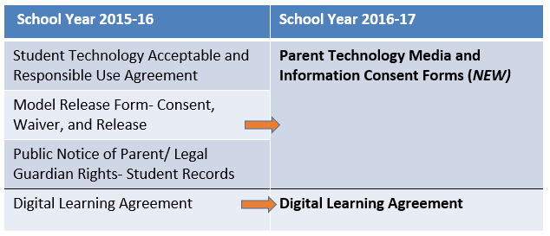
Parent Forms Bundle
Notes:
At the beginning of the school year will need to login to Parent Access/ ProgressBook to electronically sign the PTMICF. The Parent Technology Media and Information Consent Forms ask parents to consent to academic social media for high school students, photo and video of students and release of student student directory information.

Slide 39
Parent Responsibilities
Carefully read and explain the policies to your student.
Check the device frequently for damage and report any issues to the appropriate school personnel.
Carefully monitor your student’s daily use of the internet at home.

Slide 40
Student Responsibilities
General Responsibilities
Read, sign, and adhere to the:
Student Technology Acceptable and Responsible Use Form
OCPS Code of Student Conduct
Daily Responsibilities
Charge device overnight
Restart the device to receive updates weekly
Bring the device to school everyday

Slide 41
Device Accidents vs. Intentional Acts
Accidents
falls of desk
dropping device
backpack gets stepped on
liquid spills
bike/skateboard falls
Intentional Acts
objects stuck/jammed into ports
striking or throwing device
peeling keys off

Slide 42
Device Fines
 | 1st Offense | 2nd Offense | 3+ Offenses
Accident | Actual cost of repair/replacement (up to $50.00 maximum) | Actual cost of repair/replacement (up to $100.00 maximum) | Actual cost of repair/replacement.
Intentional Act | Actual cost of repair/replacement (up to $100.00 maximum) | Actual cost of repair/replacement.

Slide 43
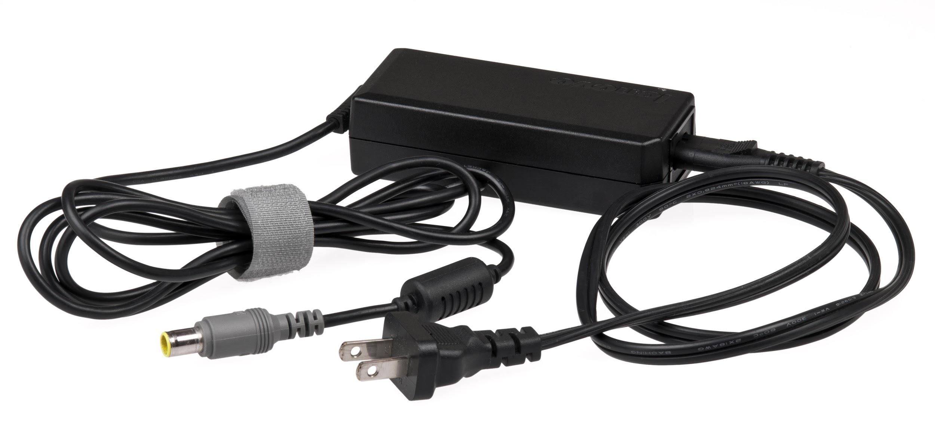
Charger Fines
 | 1st Offense | 2nd Offense | 3+ Offenses
Accident | Actual cost of repair/replacement (up to $10.00 maximum) | Actual cost of repair/replacement (up to $25.00 maximum) | Actual cost of repair/replacement.
Intentional Act | Actual cost of repair/replacement (up to $100.00 maximum) | Actual cost of repair/replacement.

Slide 44
Parent Exit Ticket

Slide 45
Parent Exit Ticket
Share your thoughts on this Google Form
This is an activity much like one your students will complete throughout the school year
https://tinyurl.com/1819DLOH
Notes:
Long link: https://docs.google.com/forms/d/e/1FAIpQLSfzURFsExtwxGtKFowvs2EJmErzBnXQa7W95SQXSG_FCDdO4g/viewform?usp=sf_link
Shortened link: https://goo.gl/forms/WwMv8jH7QSeTT9k02
Tiny URL:https://tinyurl.com/1819DLOH

Slide 46
Open House at
Lake Como School
Thank you for attending the

